Slide 1
Spatial Analysis of Colorado Zillow Housing Listings
Mapping, regression, nearest-neighbor analysis, clustering, and interactive Leaflet visualization
123
44
82
cleaned listings
cities represented
ZIP codes
Xiaoling Sundberg | STA6709 Spatial Statistics
STA6709 Spatial Statistics | 1

Slide 2
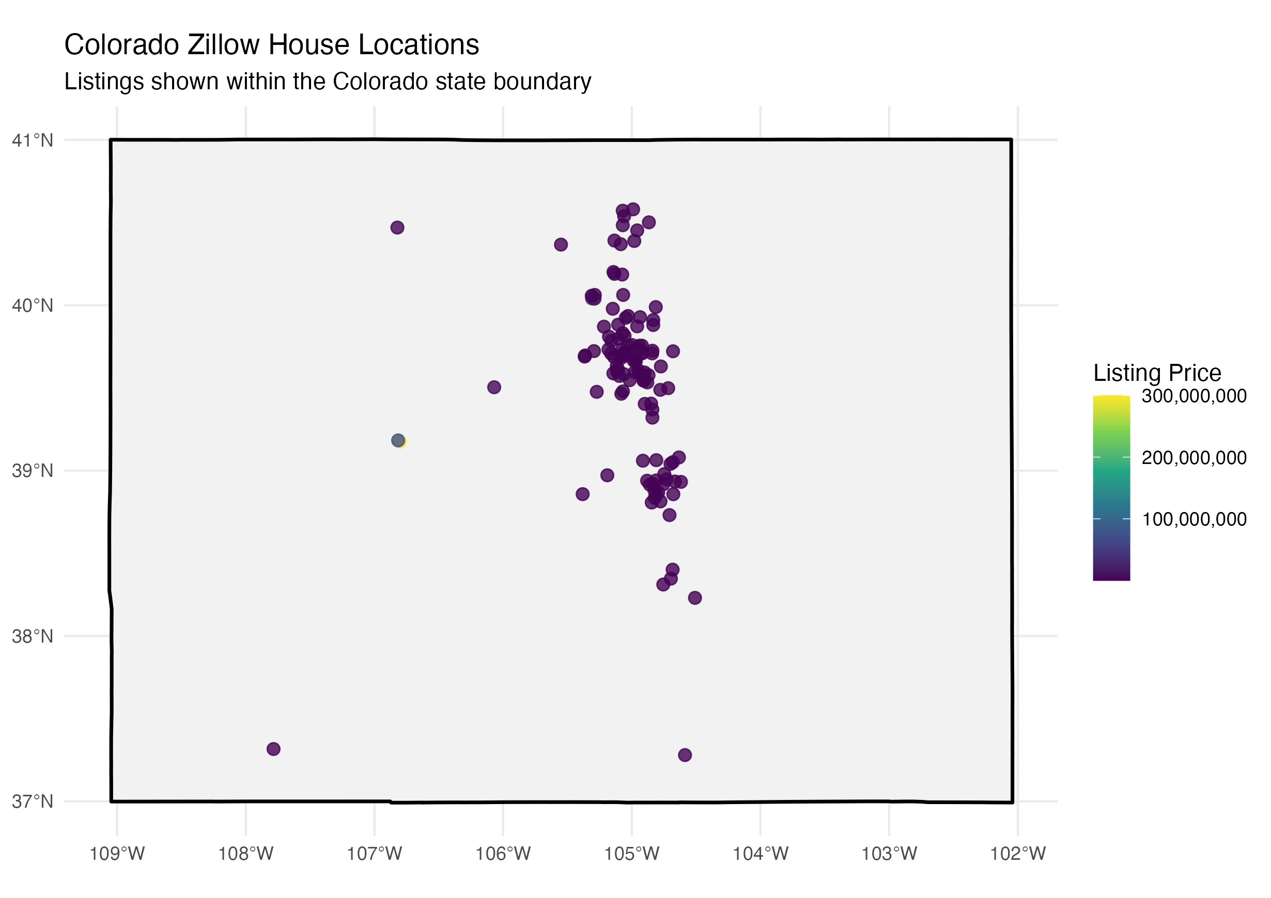
Project Objective
Use spatial methods to understand where listings are located and how prices vary.
Treat Zillow listings as spatial points using latitude and longitude.
Map listings within Colorado state and county polygon boundaries.
Use regression to evaluate how price relates to housing characteristics and location.
Use nearest-neighbor and cluster analysis to assess whether listings are random or geographically concentrated.
Create an interactive Leaflet map for exploring individual listings.
STA6709 Spatial Statistics | 2

Slide 3
Dataset and Preparation
The data were cleaned before mapping, modeling, and spatial analysis.
Metric | Value
Number of listings | 123
Number of cities | 44
Number of ZIP codes | 82
Minimum price | $49,999
Median price | $635,000
Mean price | $3,972,322
Maximum price | $300,000,000
Median area square feet | 2,540
Median price per square foot | $254
Duplicate listing IDs were removed.
Records with missing price, coordinates, beds, baths, or square footage were excluded.
Price per square foot and log price were created for analysis.
Coordinates were checked to keep listings inside a reasonable Colorado range.
STA6709 Spatial Statistics | 3

Slide 4
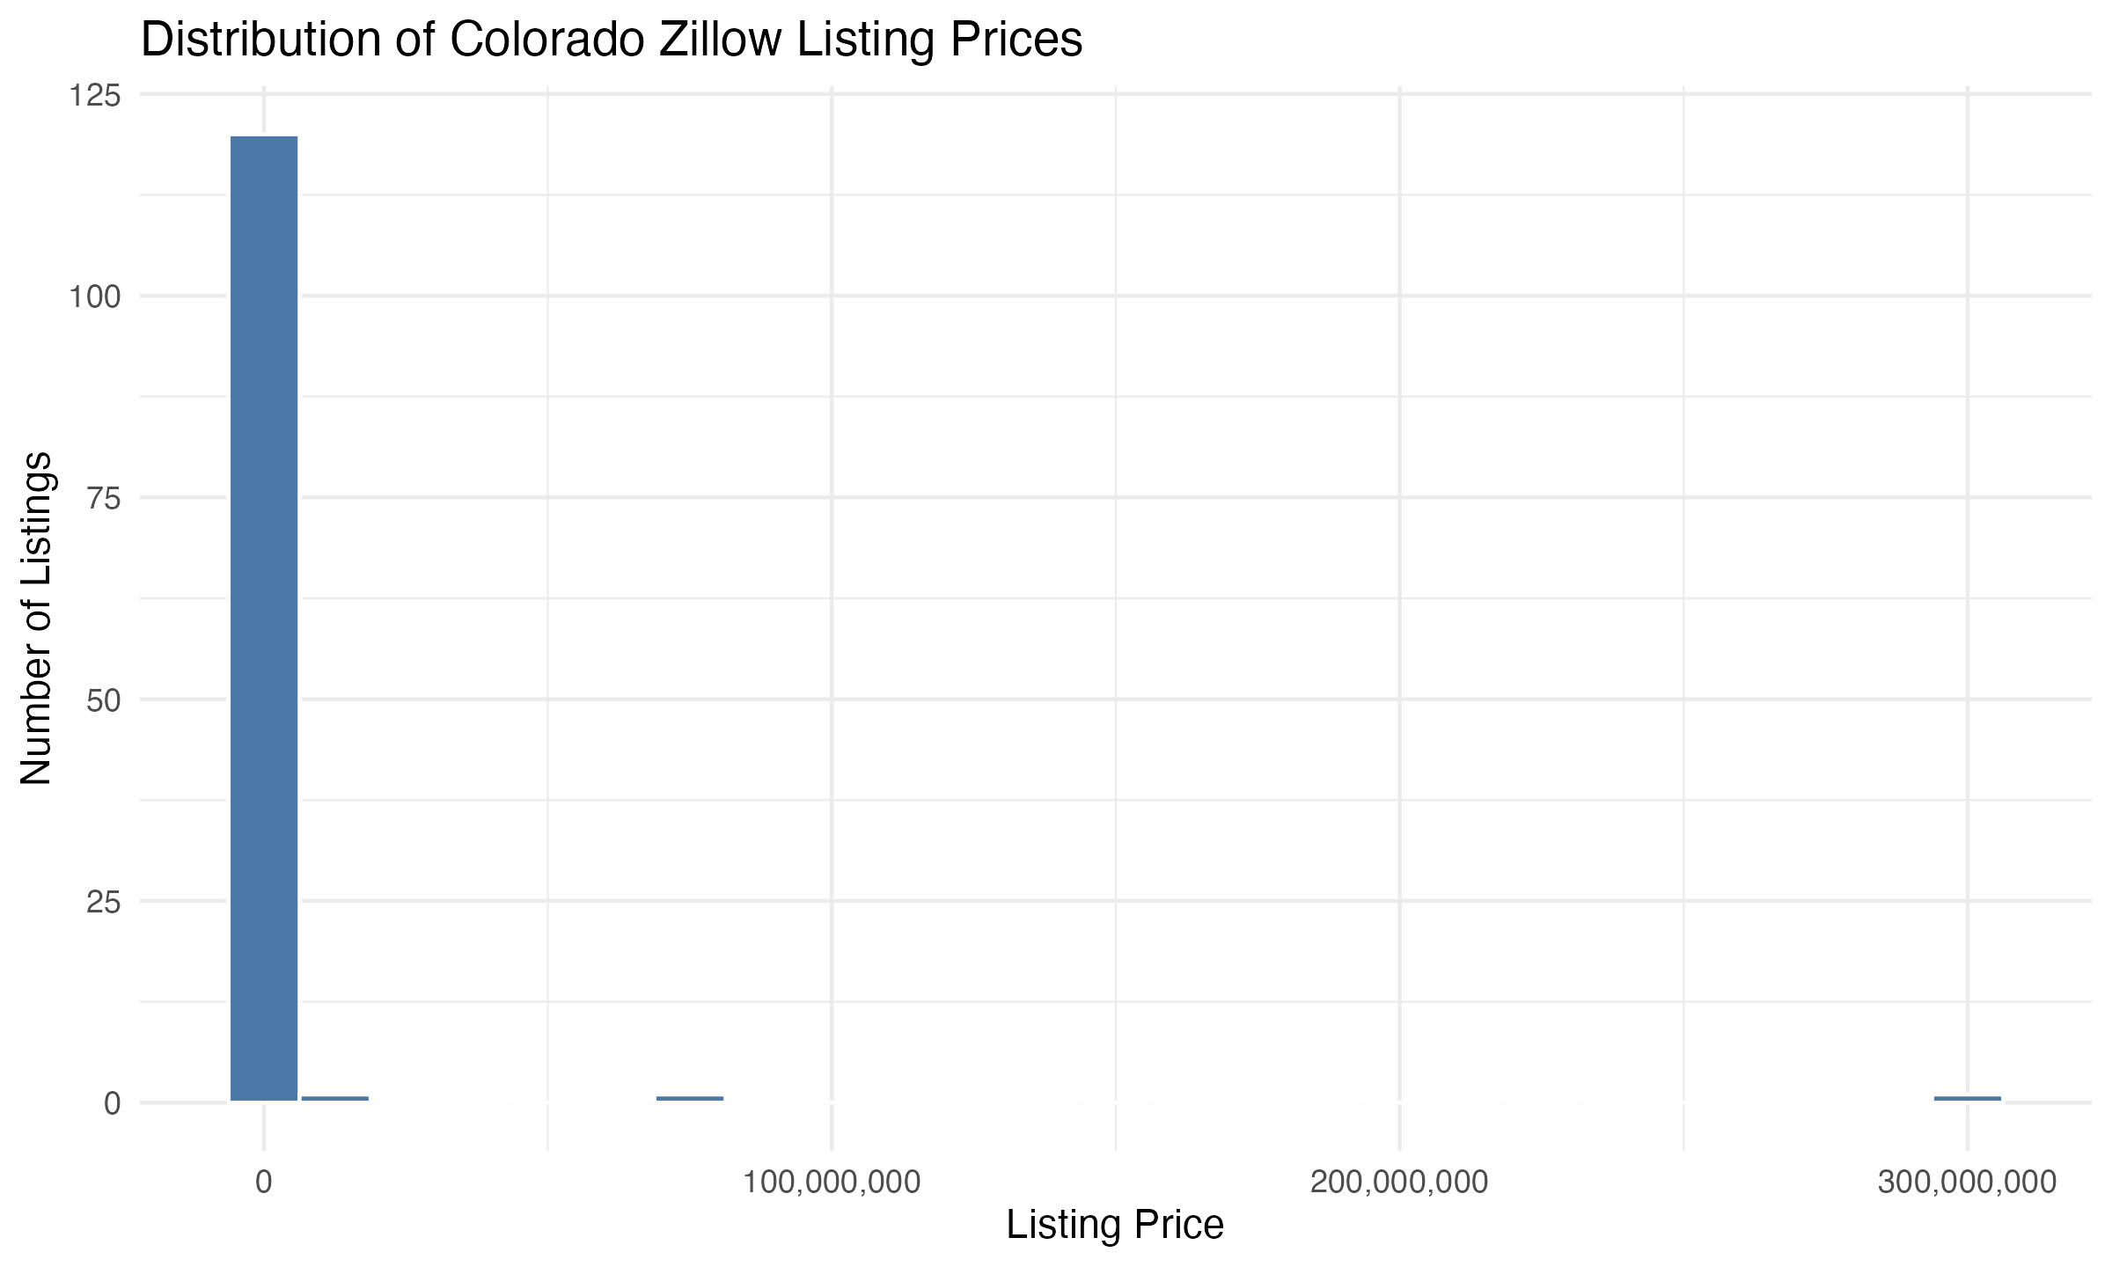
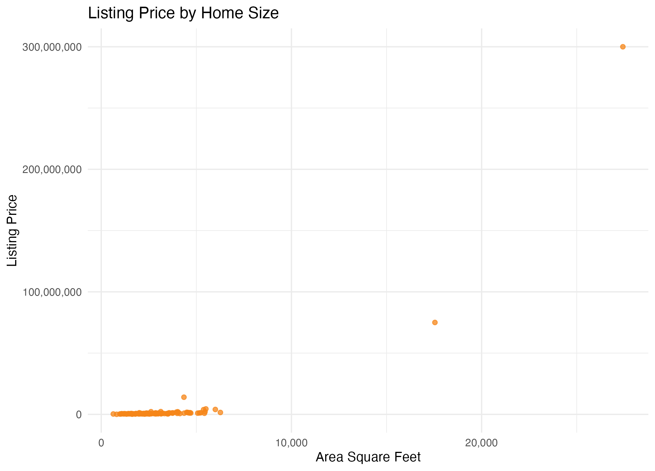
Exploratory Summary: Price Is Highly Skewed
A small number of luxury listings strongly affects the mean.
Most listings fall in moderate price ranges, but a few very high-value homes create a long right tail. This is why log listing price was used in the regression model.
STA6709 Spatial Statistics | 4

Slide 5
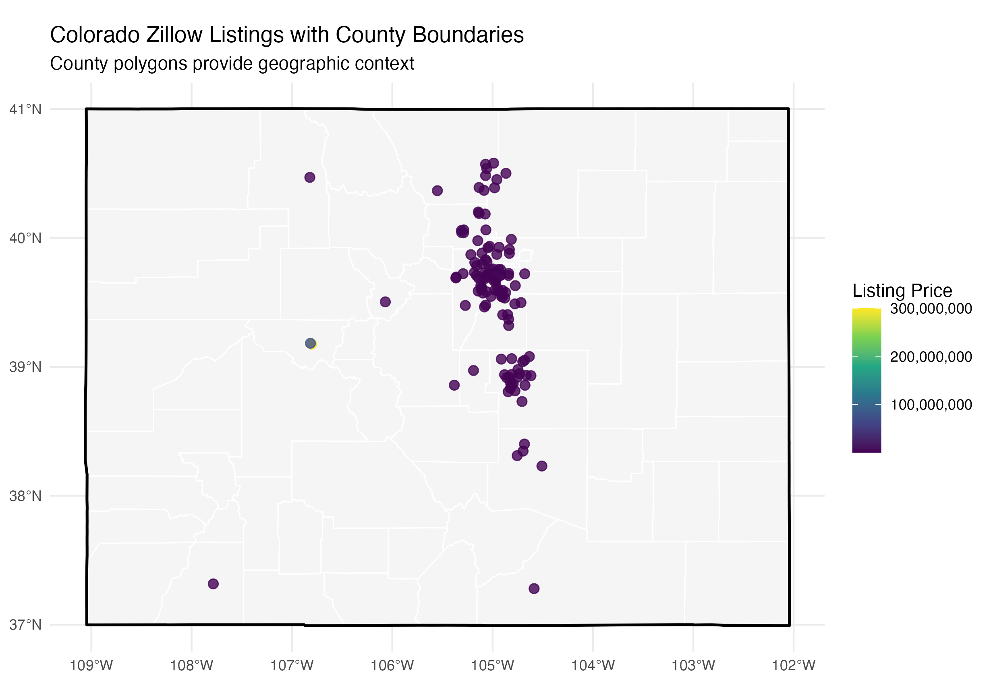
Listings Are Concentrated Along the Front Range
The map shows a strong geographic concentration rather than an even statewide pattern.
Listings are concentrated near Denver, Colorado Springs, Boulder, and surrounding communities.
County polygons provide geographic context for the listing points.
The spatial pattern suggests housing data should be interpreted geographically, not only numerically.
STA6709 Spatial Statistics | 5

Slide 6
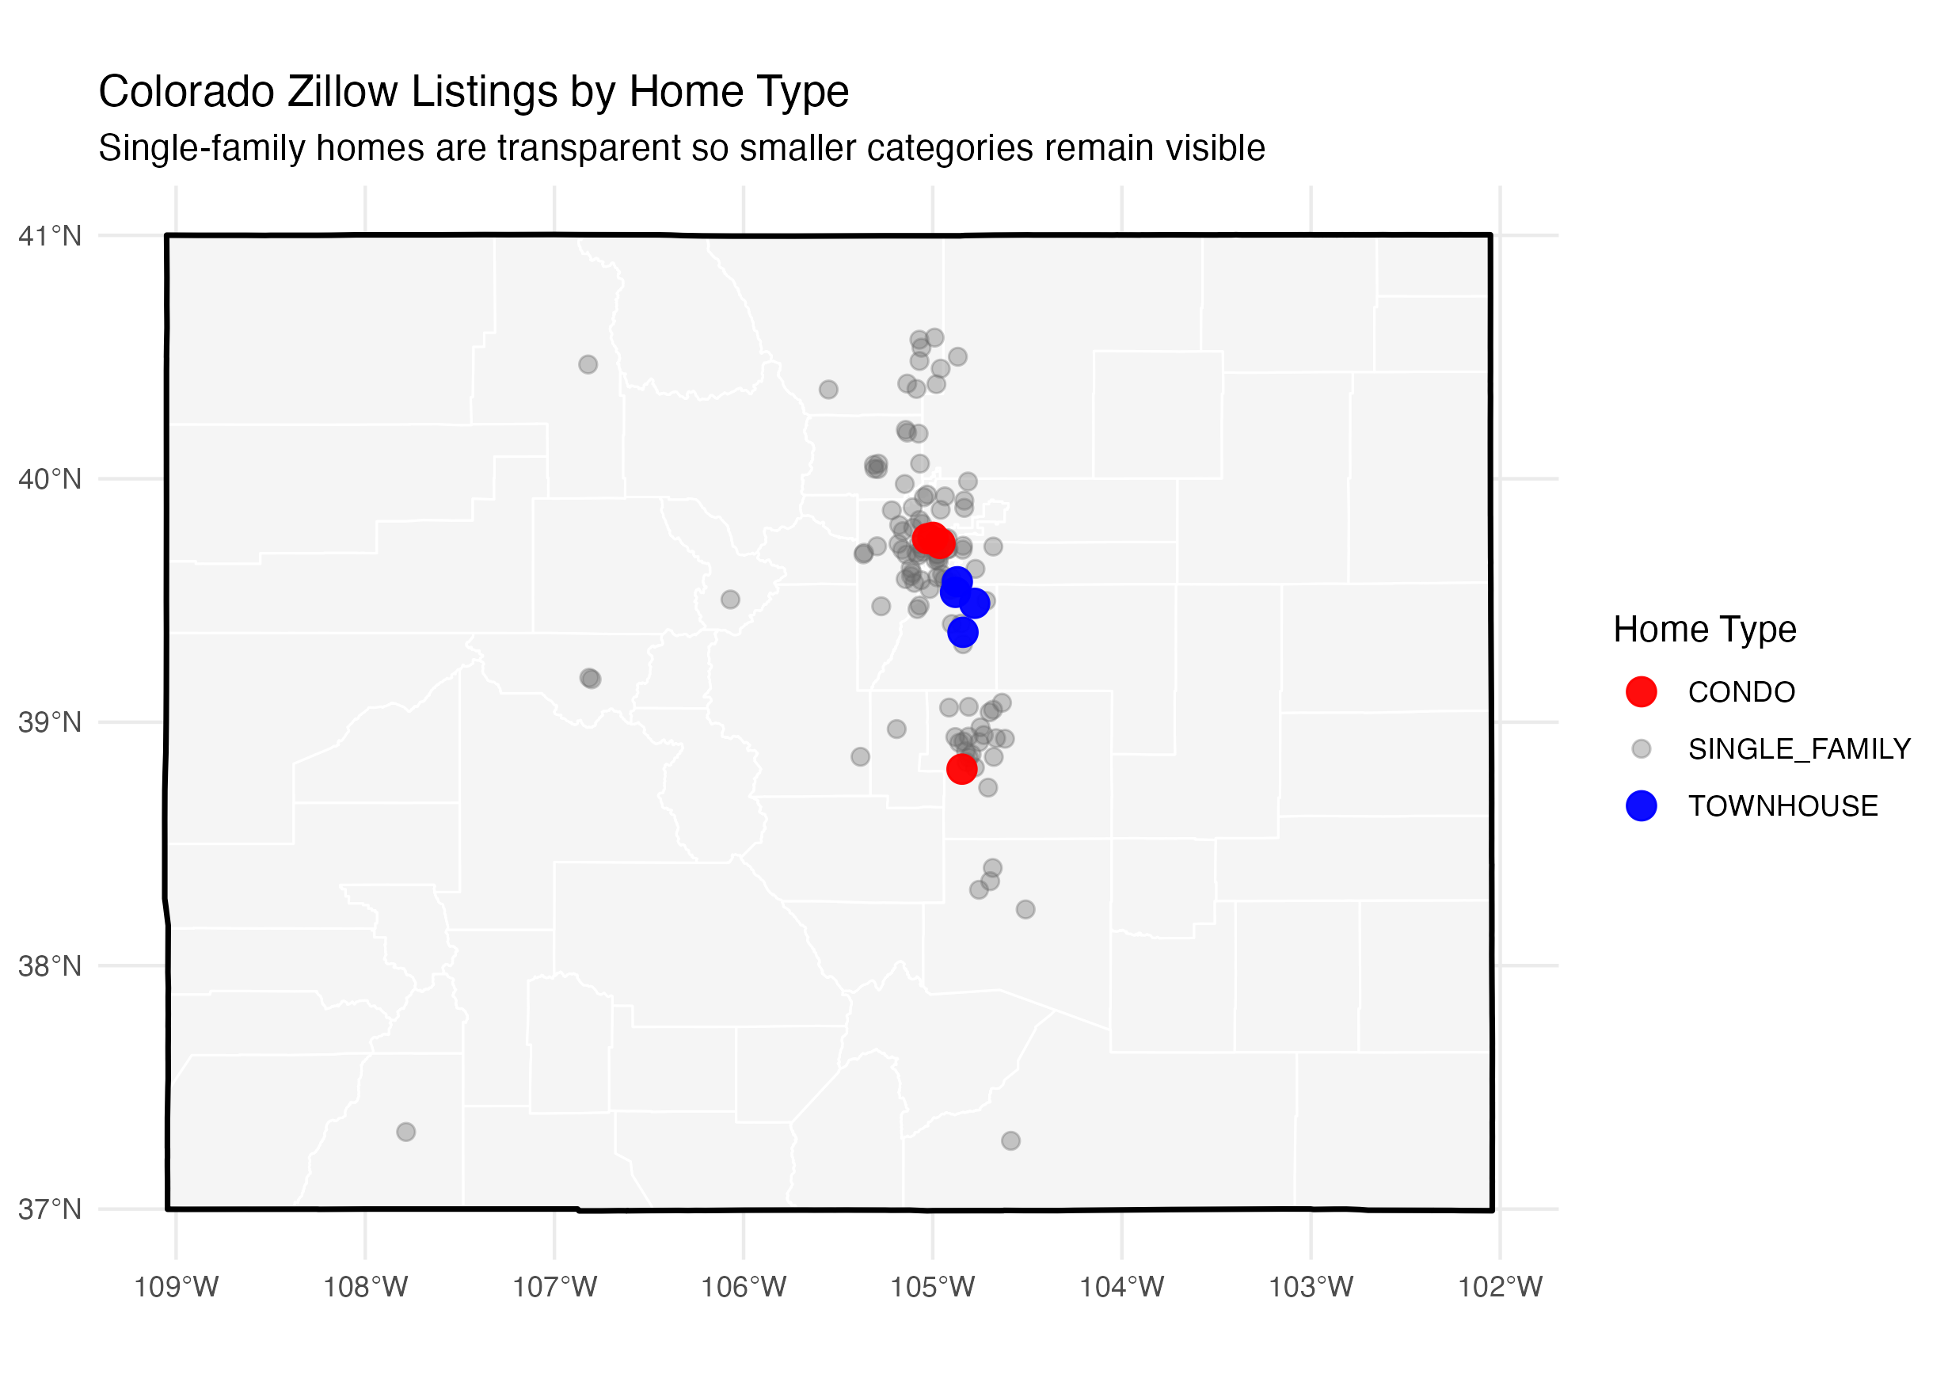
Home Type Pattern
Single-family homes dominate the sample, so smaller groups should be interpreted cautiously.
Home Type | Listings | Median Price | Median Area
Single-family | 113 | $650,000 | 2,583
Condo | 5 | $375,000 | 1,201
Townhouse | 5 | $585,000 | 1,780
The transparent single-family layer keeps condos and townhouses visible.
Small condo and townhouse counts mean their summary statistics are less stable.
Home type was included as a predictor in the regression model.
STA6709 Spatial Statistics | 6

Slide 7
Regression Analysis
Log listing price was modeled using property characteristics and location.
Variable | Estimate | p-value
Beds | -0.020 | 0.6751
Baths | 0.111 | 0.0432
Area Sq Ft | 0.000195 | <0.001
Single Family | 0.442 | 0.0486
Townhouse | 0.435 | 0.1498
Days on Zillow | -0.00477 | 0.0001
Latitude | 0.163 | 0.0236
Longitude | -0.437 | <0.001
Square footage, bathrooms, days on Zillow, latitude, and longitude were meaningful predictors.
The location coefficients show that geography remained important even after adding property characteristics.
Using log price helped reduce the influence of extreme listing prices.
STA6709 Spatial Statistics | 7

Slide 8
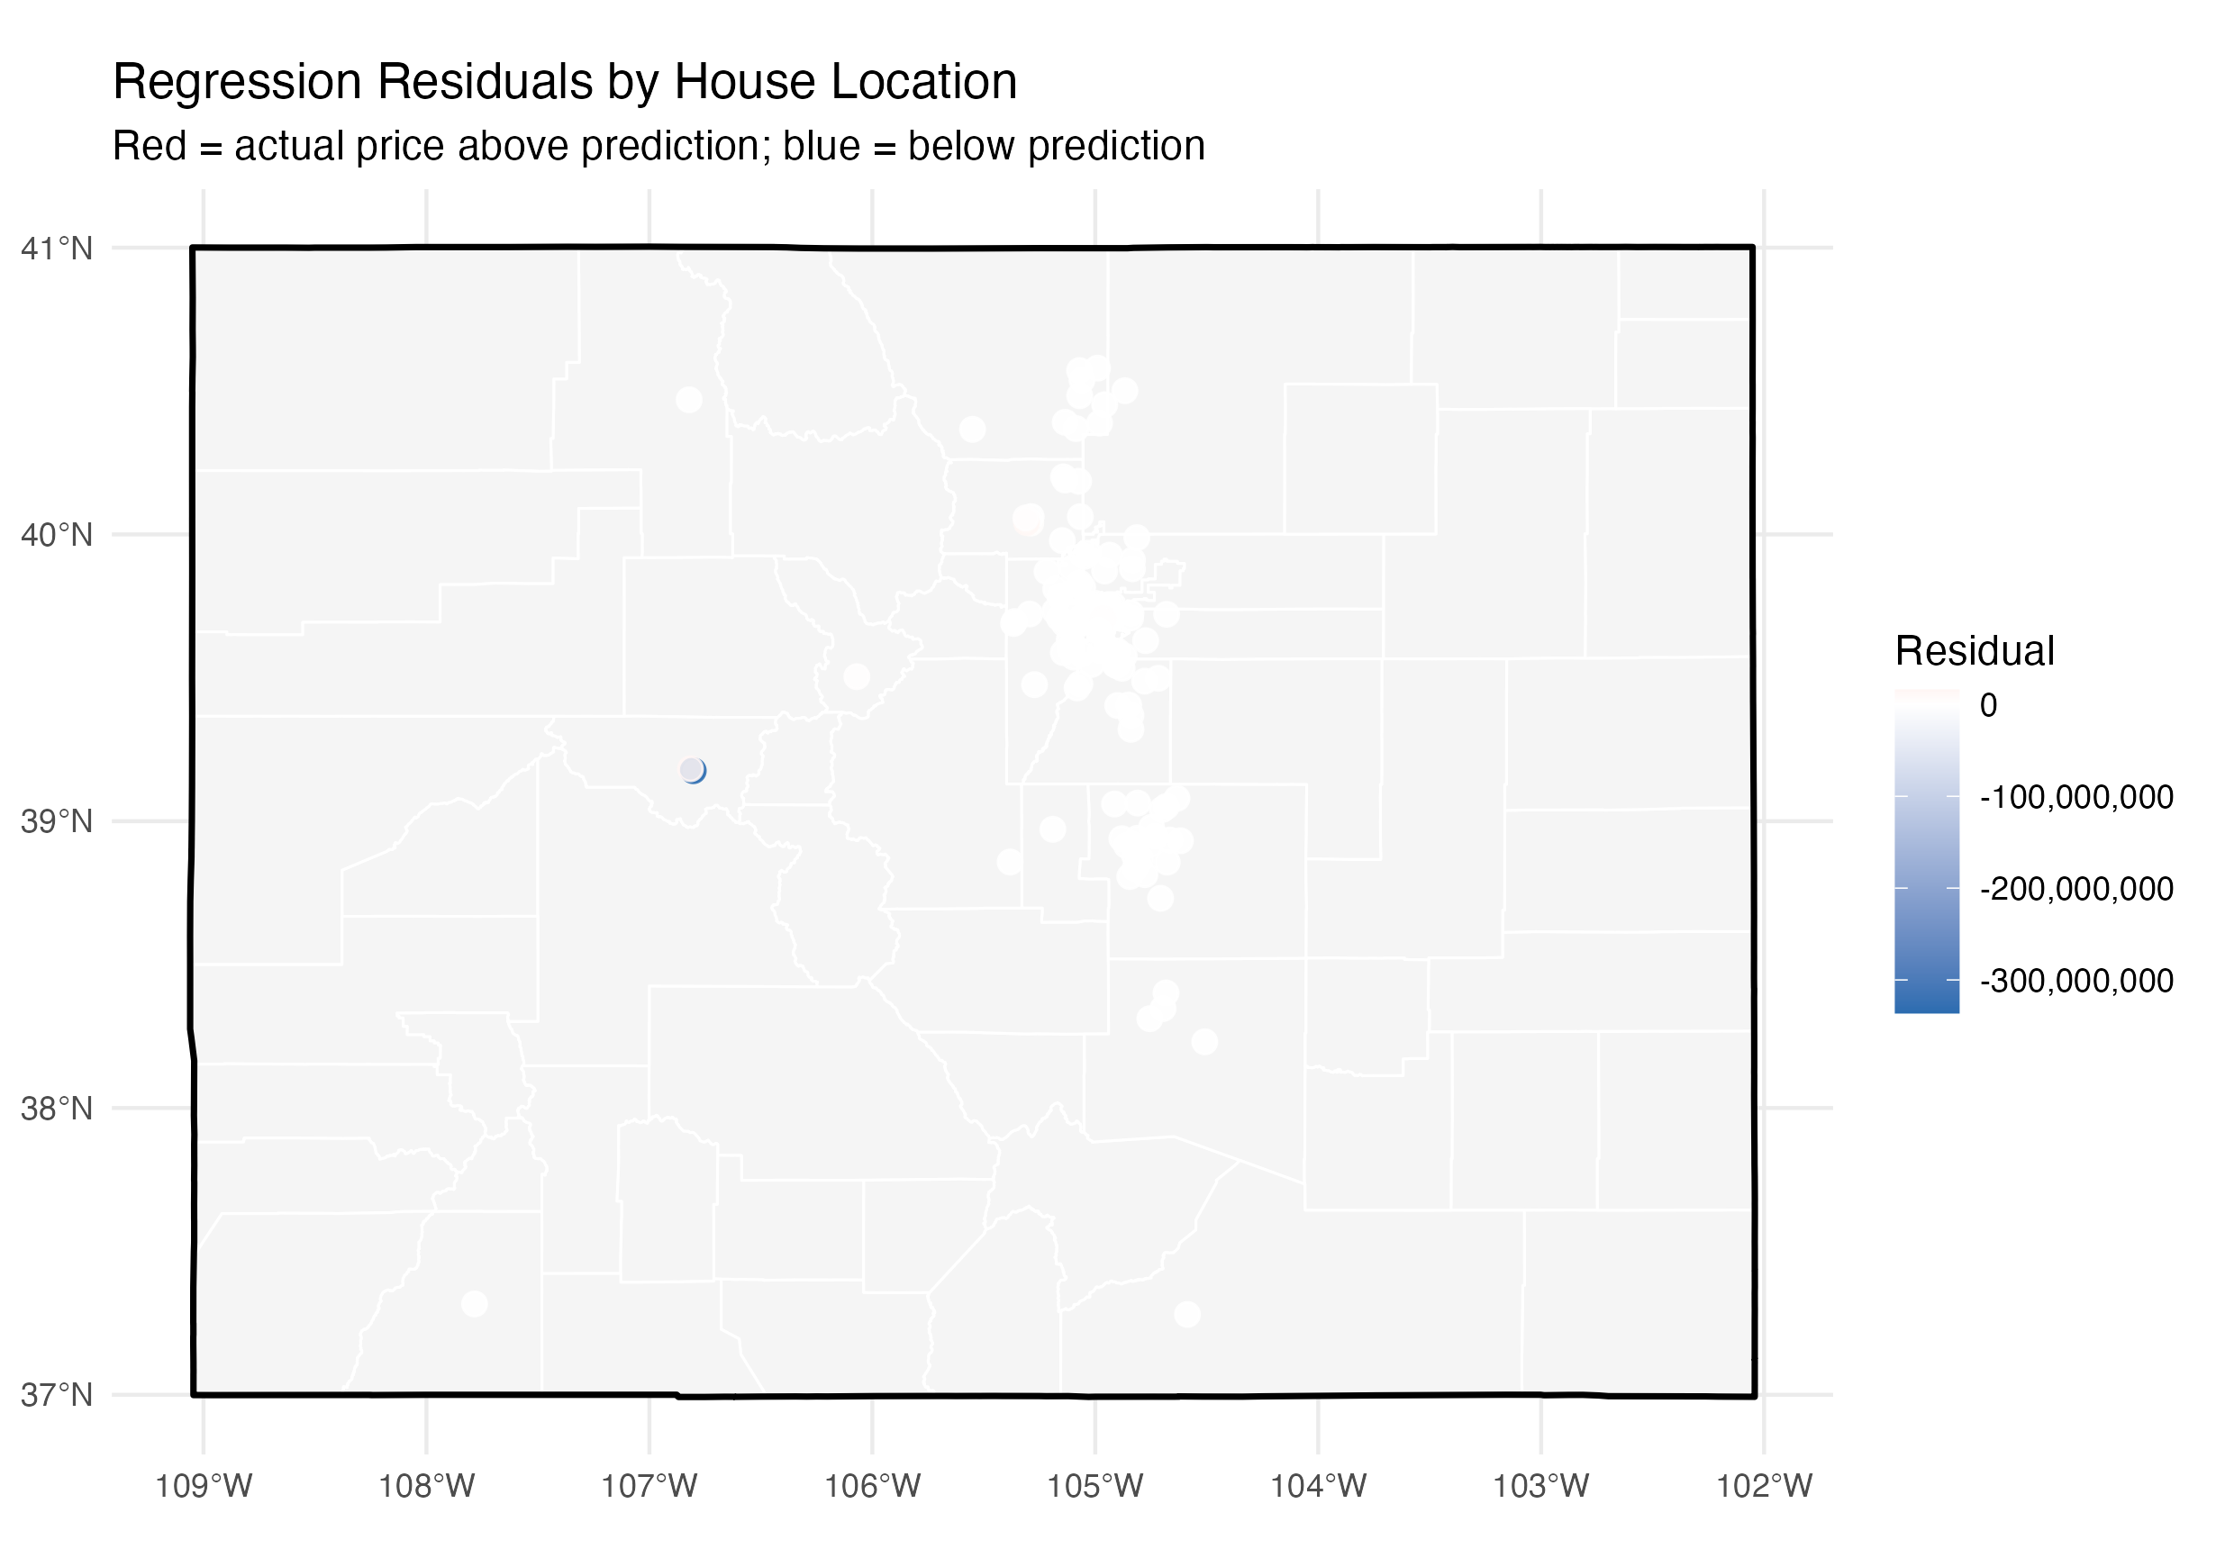
Regression Residuals by Location
Residual mapping shows where the model overpredicts or underpredicts price geographically.
Positive residuals mean actual price was higher than predicted.
Negative residuals mean actual price was lower than predicted.
Large residuals may reflect factors not in the model, such as views, neighborhood quality, school zones, or luxury amenities.
STA6709 Spatial Statistics | 8

Slide 9
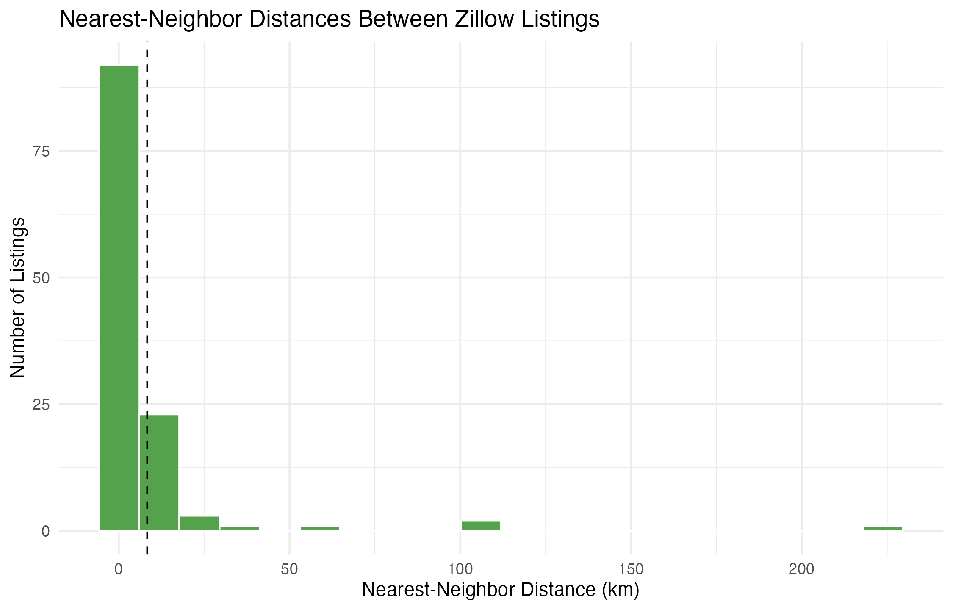
Nearest-Neighbor Analysis
Listings are closer together than expected under complete spatial randomness.
Metric | Value
Listings | 123
Study area | 81,832.085 sq km
Observed mean NN distance | 8.356 km
Expected mean NN distance | 12.897 km
Nearest-neighbor index | 0.648
Interpretation | Clustered
Because the index is less than 1, the listings are spatially clustered rather than randomly distributed.
STA6709 Spatial Statistics | 9

Slide 10
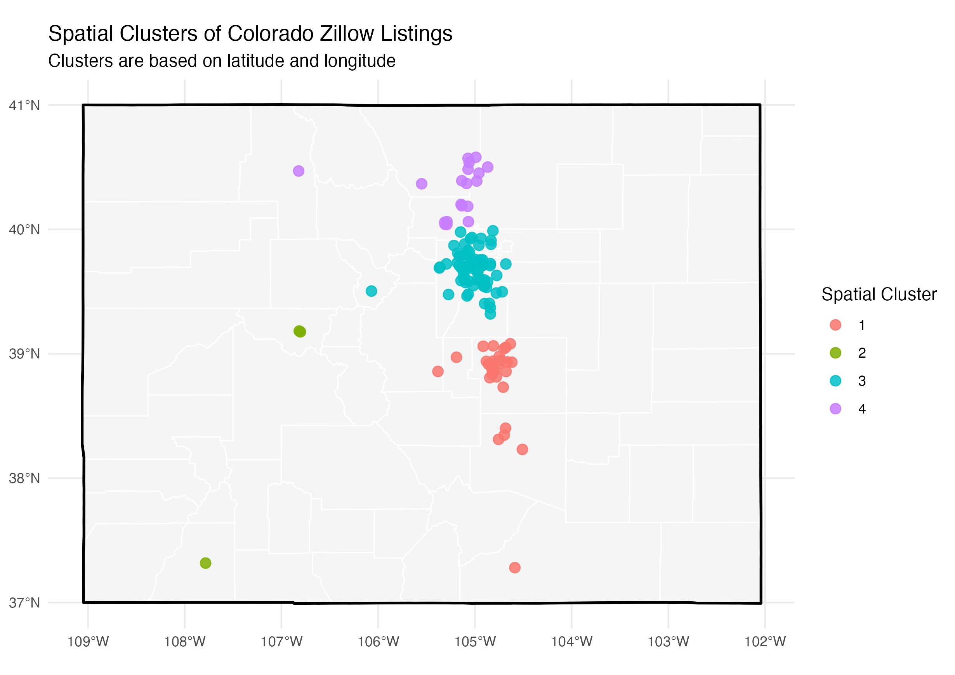
Spatial Cluster Analysis
Coordinate-based clusters summarize regional listing groups.
Cluster | Count | Median Price | Approx. Location
I | 29 | $460,000 | Southern CO / Colorado Springs
II | 3 | $75,000,000 | Mountain / luxury listings
III | 72 | $662,500 | Denver & central Front Range
IV | 19 | $650,000 | Northern Front Range / Boulder
The largest cluster is around Denver and the central Front Range.
The small luxury cluster has very high prices but only three listings.
Clusters help connect price patterns to regional geography.
STA6709 Spatial Statistics | 10

Slide 11
Interactive Leaflet Map
The final HTML map allows viewers to inspect individual listings.
Shows Colorado boundary, county polygons, and Zillow listing points.
Popups include address, city, actual price, predicted price, residual, home type, beds, baths, area, and cluster.
Submitted separately as a zipped HTML map so it can be opened in a web browser.
Submitted file
colorado_zillow_interactive_map_SUBMIT.zip
Unzip, then open colorado_zillow_complete_interactive_map.html
STA6709 Spatial Statistics | 11

Slide 12
Conclusion
Spatial analysis added insight that tables alone could not show.
0.648
72
$635K
$3.97M
nearest-neighbor index
largest cluster
median listing price
mean listing price
Colorado Zillow listings in this sample are clustered, especially along the Front Range.
Location remains important after accounting for home characteristics in regression.
Residual and cluster maps help identify geographic patterns that are not obvious from tables.
The project demonstrates how mapping, modeling, and interactive visualization can work together in spatial housing analysis.
STA6709 Spatial Statistics | 12

